Slide 1
Transfer Learning
Presented by:
Aria Mostajeran
Zahra Salarian
Pariya Mehrbod
Kian KashfiPour

Slide 2
Objectives
An Introduction to Transfer Learning
Problems that result in demand for Transfer Learning
What is Transfer Learning?
How to employ Transfer Learning?
Transfer Learning Models
Implementation and Results of A Transfer Learning Problem

Slide 3


Presentation Path
Models
References
Introduction
Transfer Learning
Implementation
And Results

Slide 4
1
Introduction
What are the problems?
What is transfer learning?

Slide 5
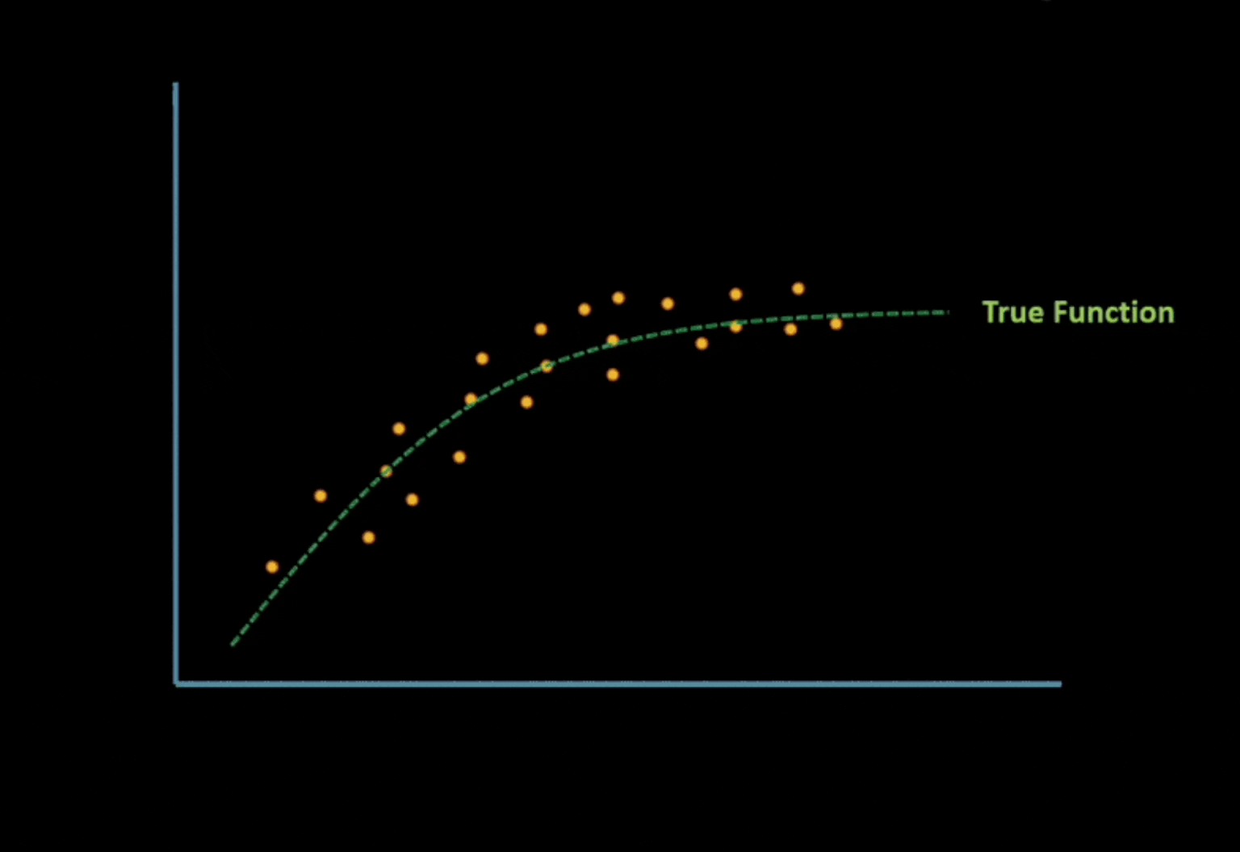
What are the problems?
Lack of data
Overfitting
Underfitting

Slide 6
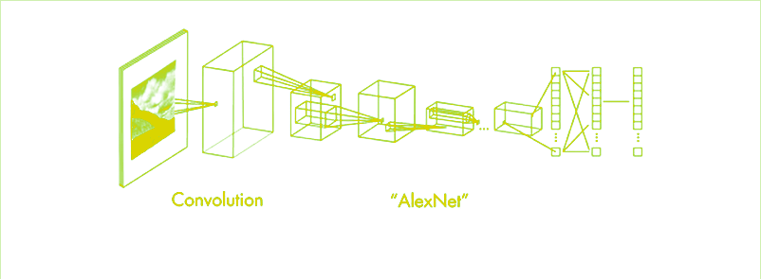
What are the problems?
Time shortage

Slide 7
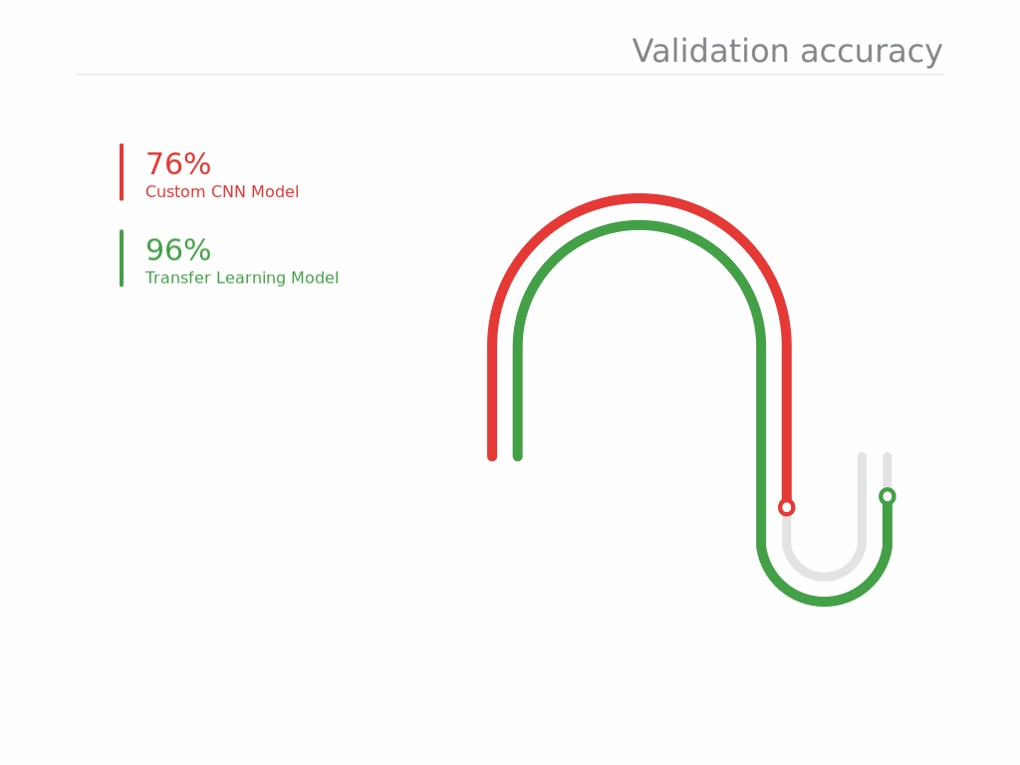
What is transfer learning?

Slide 8
2
Transfer Learning
What is transfer learning?
Fine Tuning

Slide 9
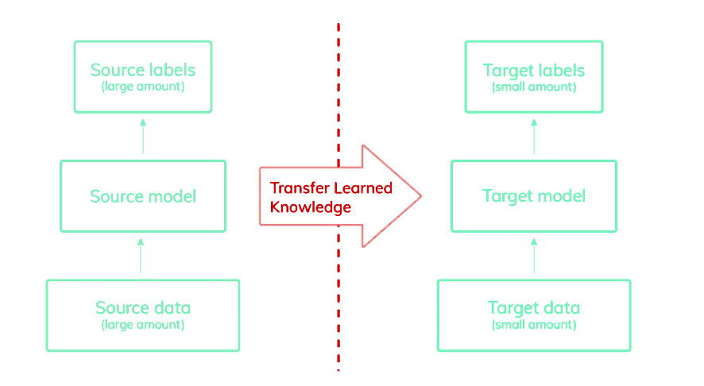
Overview

Slide 10
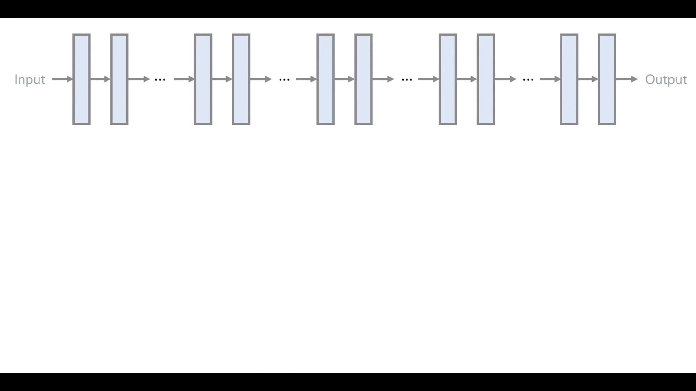
Convolutional Network

Slide 11
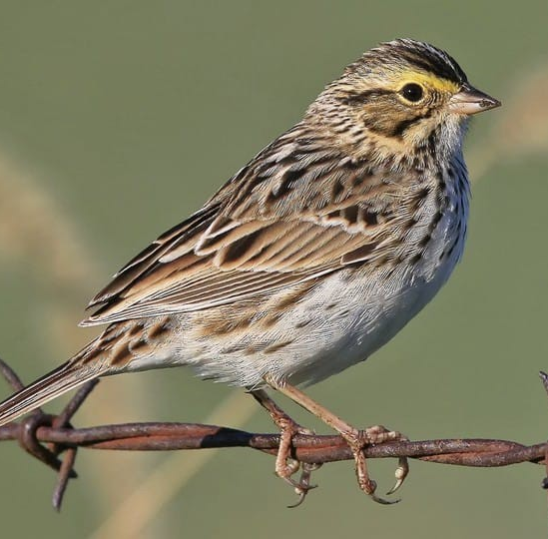
Transfer learning steps
1. Obtain a pre-trained model

Slide 12
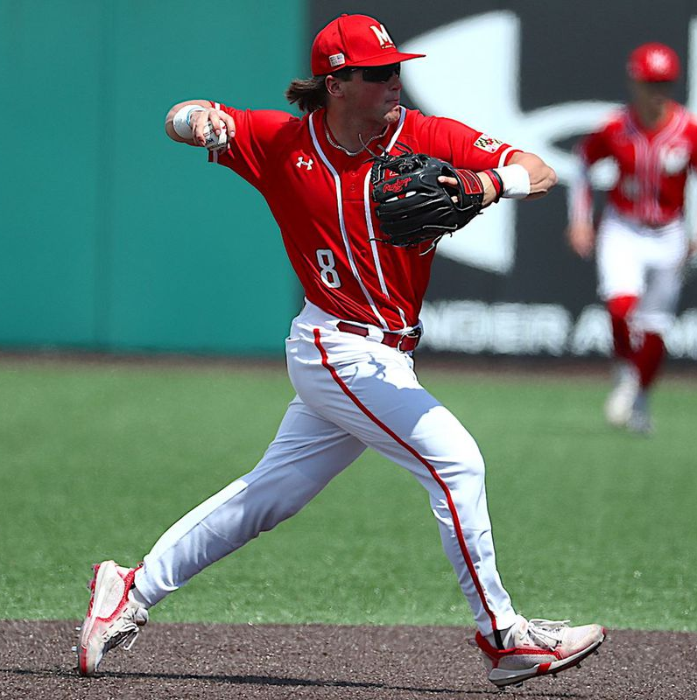
Transfer learning steps
2. Create a base model
Pre-trained model
Input
3. Freeze layers
4. Train new trainable layers

Slide 13
Transfer learning steps
5. Fine tuning
Pre-trained model
Input

Slide 14
3
Models
Inception
Xception
VGG-16
ResNet-50

Slide 15
Inception
Filter concatenation
3x3 convolutions
5x5 convolutions
1x1 convolutions
1x1 convolutions
1x1 convolutions
1x1 convolutions
3x3 max pooling
Filter concatenation

Slide 16
Inception
The architecture of this model includes:
1×1 convolution with 128 filters
Fully connected layer with 1024 units and a rectified linear activation
Dropout layer with 70% ratio
Linear layer with softmax loss as the classifier
Merits:
As multiple Conv filters applied on the same input result in multi-level feature extraction and reduce computational cost.
High-performance gain on CNN.
Trains faster than the family of VGG
The size of the model is relatively smaller than VGG, where VGG can weigh up to 500MB’s inception is about 100MB’s

Slide 17
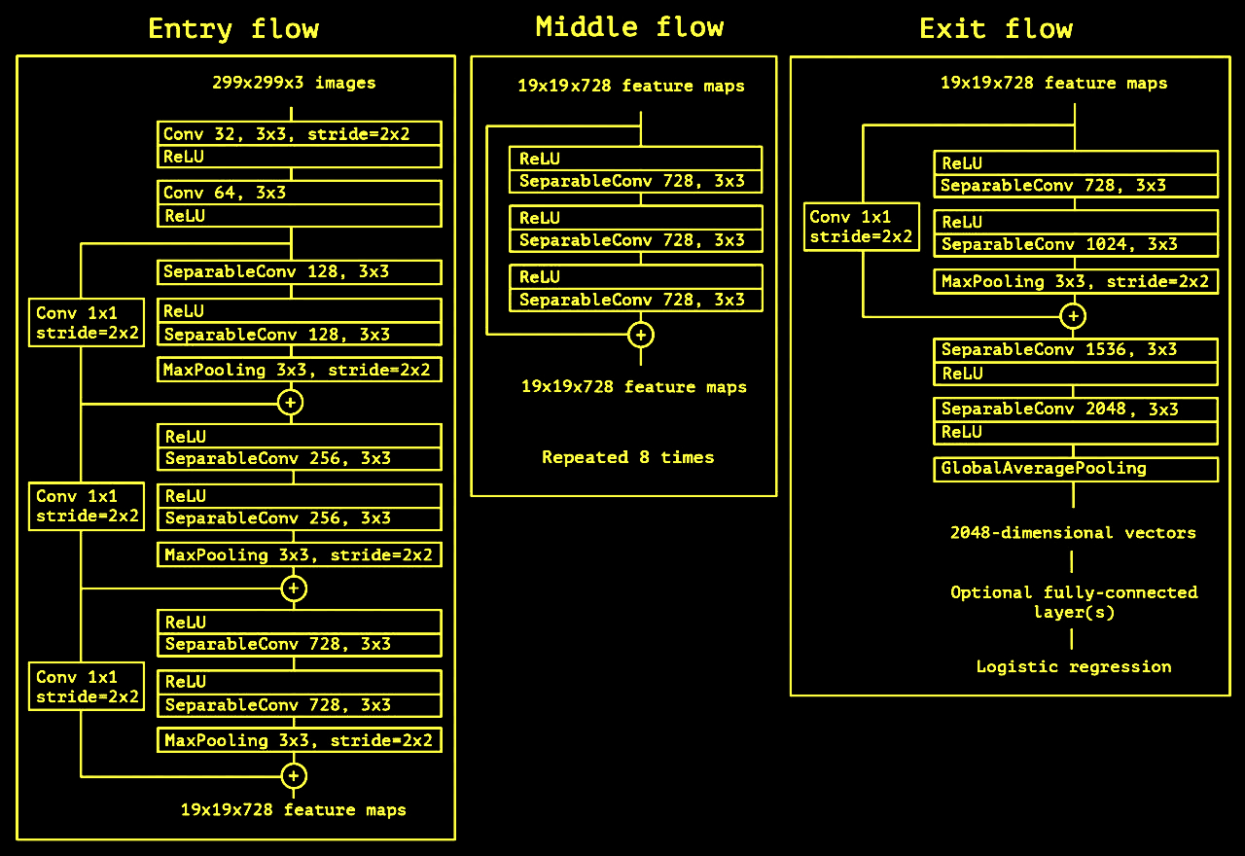
Xception

Slide 18
Xception
The architecture of this model includes:
A linear stack of depthwise separable convolution layers with residual connections
Only 40 lines of code by using high-level APIs such as Keras or Tensorflow
Merits:
Linear stack layers make training faster than Inception.
Performing better with almost the same parameter is a key advantage of this module.

Slide 19
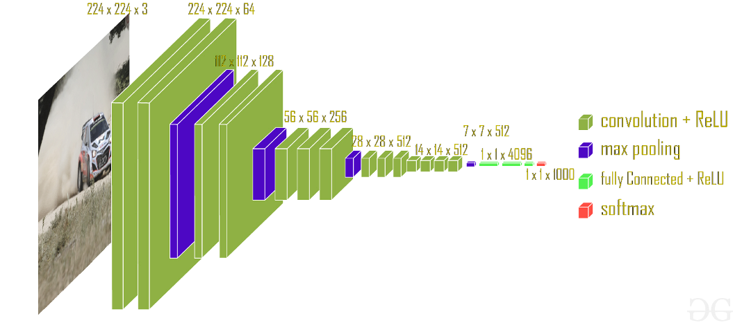
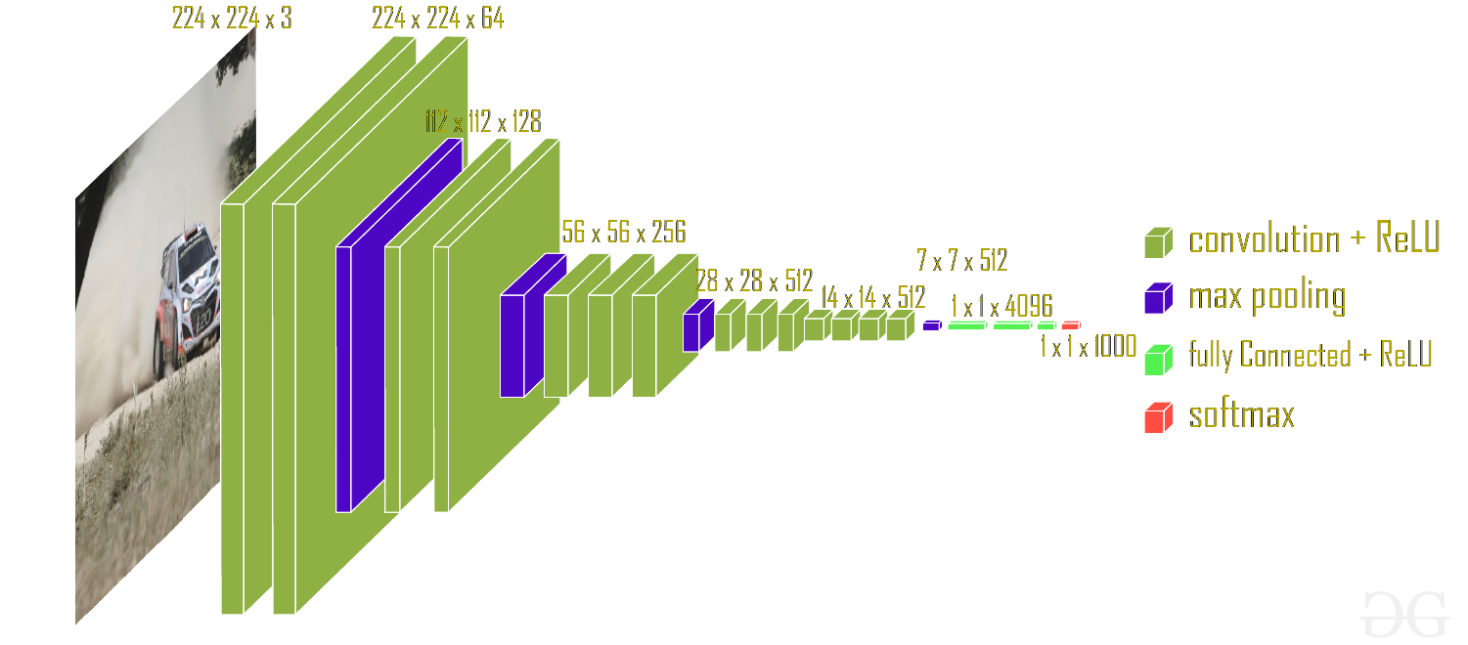
VGG-16

Slide 20
VGG-16
The architecture of this model includes:
The network is recognized by its simplicity using only a stack of 3×3 convolutional layers on
top of each increasing depth and volume size handled by the max-pooling layers.
Two fully connected layers each with 4096 nodes are then followed by a softmax layer.
Merits:
Easy to understand and explainable
It is good for classical problems like cats vs dogs classification to achieve a baseline of about 80%
Demerits:
The larger number of weights parameters resulting in high inference time

Slide 21
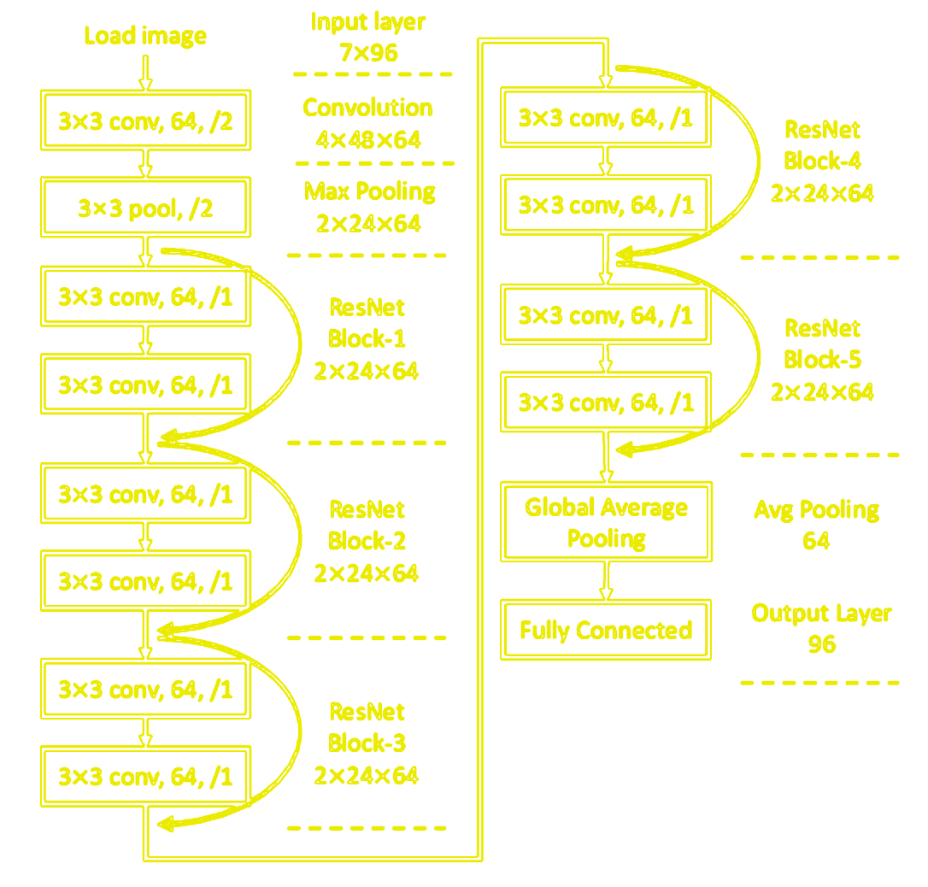
ResNet-50

Slide 22
ResNet-50
Merits:
Helps to tackle the problem of vanishing gradient
Accelerate the speed of training
Gives higher accuracy specially for classification problem
It tries to learn the difference between the learned features and if the learned feature is not useful in the final decision weights become zero for the particular feature.
Demerits:
Increased complexity of architecture
Adding skip connections which may take into account dimensionality between layers.

Slide 23
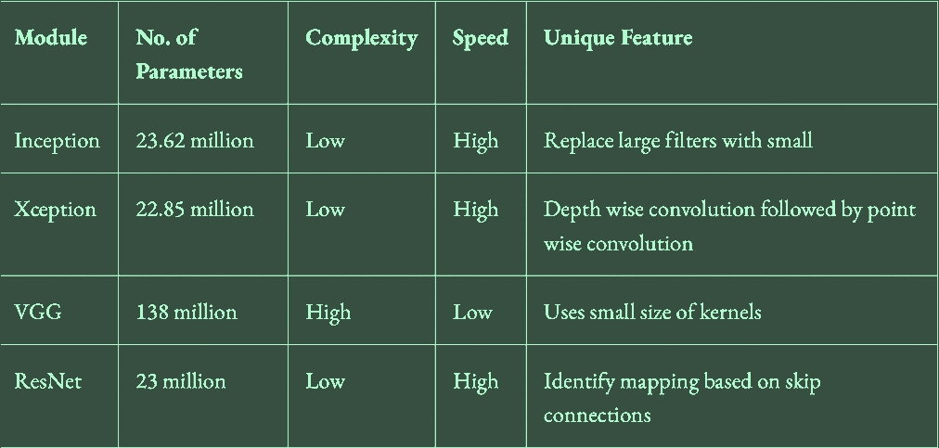
Feature Comparison of Different Transfer Learning Model

Slide 24
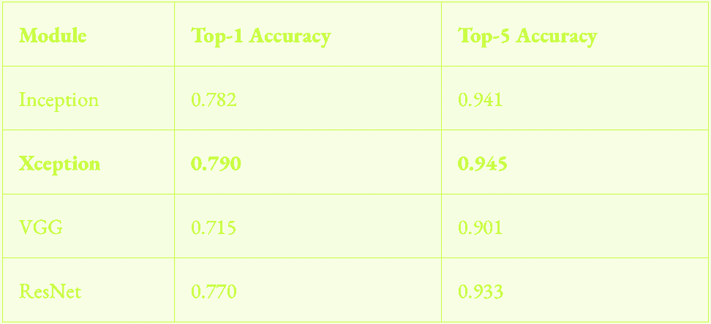
Comparison of Models with respect to Classification Accuracy

Slide 25
Implementation And Results
4
Dataset Specifications
Creating the base model
How transfer learning helped
Models and Comparison

Slide 26

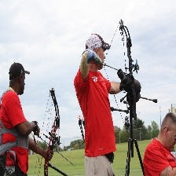
Dataset Specifications
100 sports image dataset
100 classes 13572 training image

Slide 27

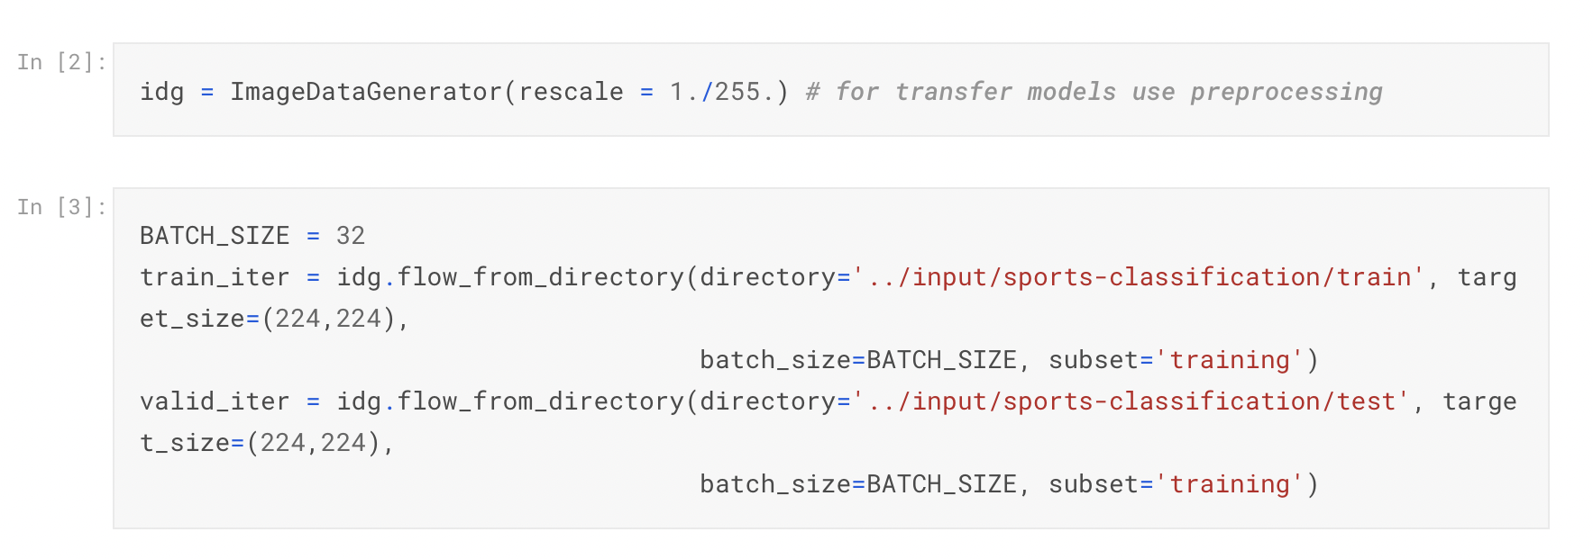
Reading Data

Slide 28
Creating the base model
Pre-trained model
.
.
.
100
.
.
.
256

Slide 29
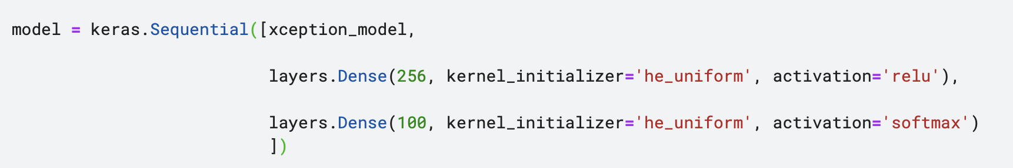
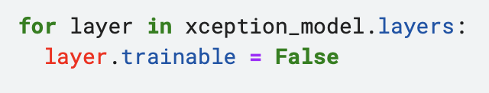
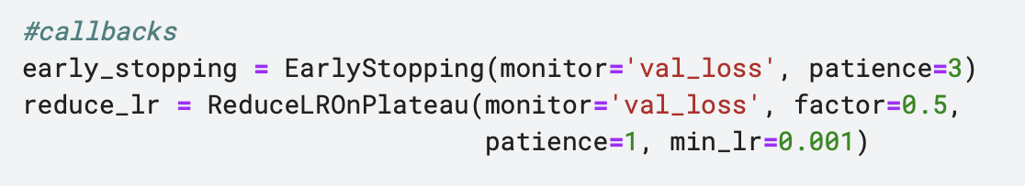
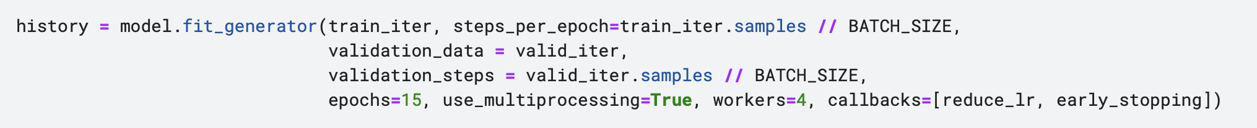
Creating the base model

Slide 30
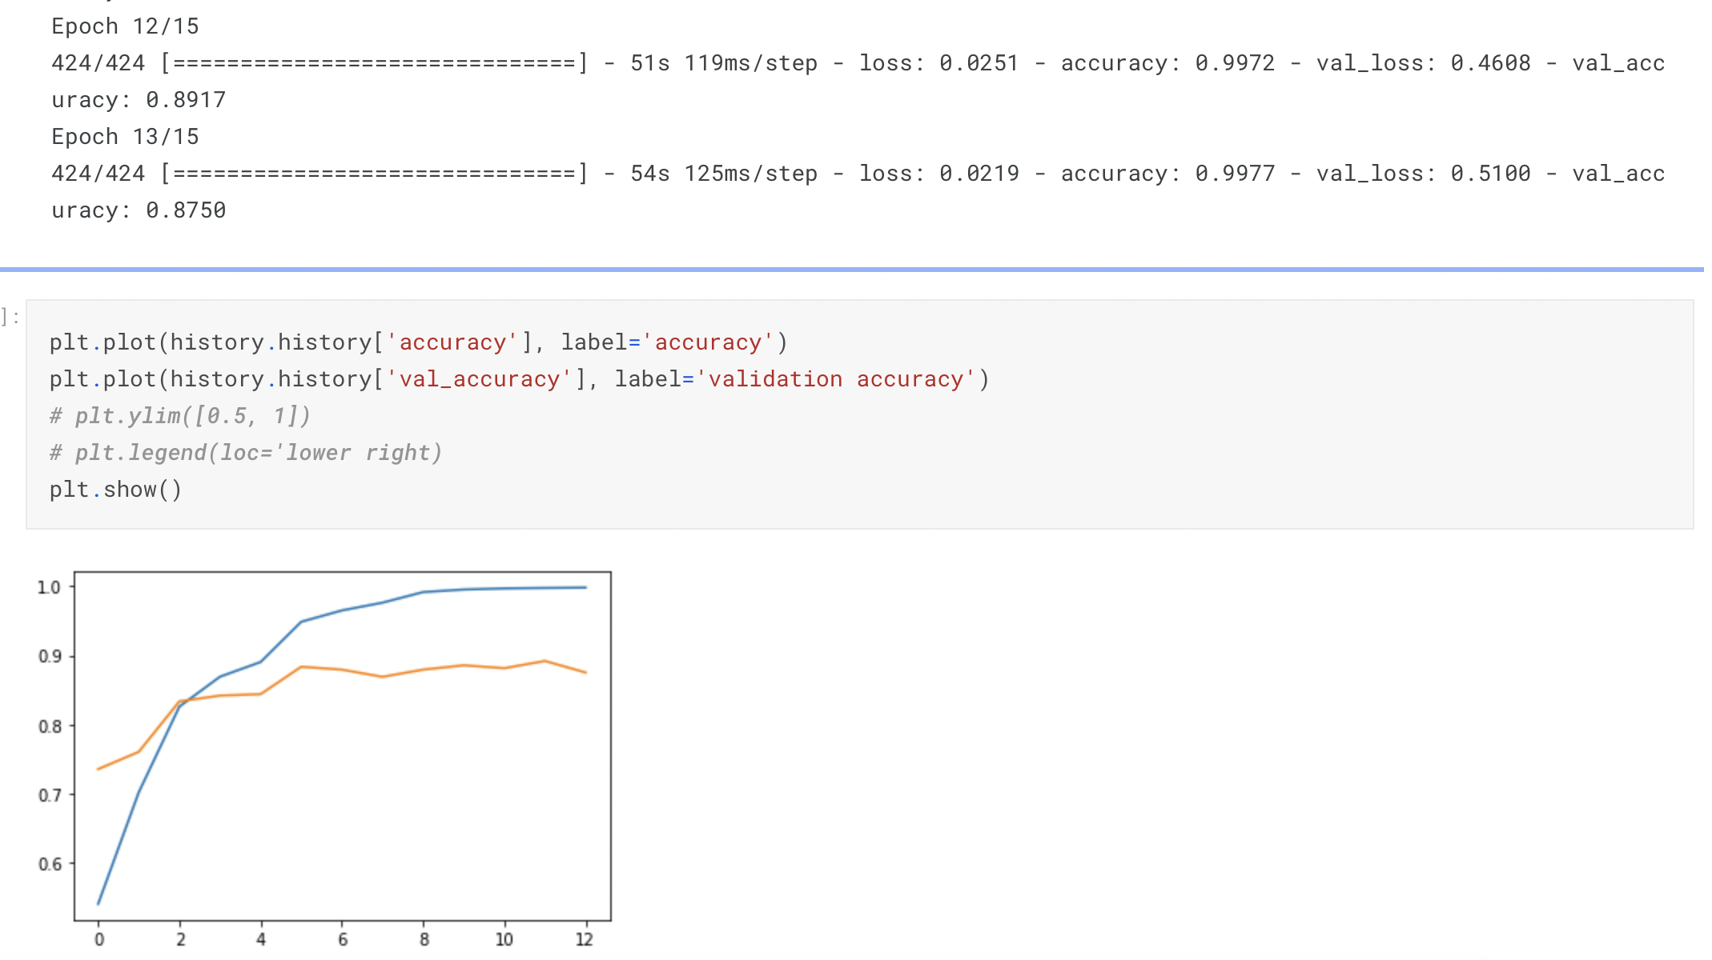
Executing the base model

Slide 31
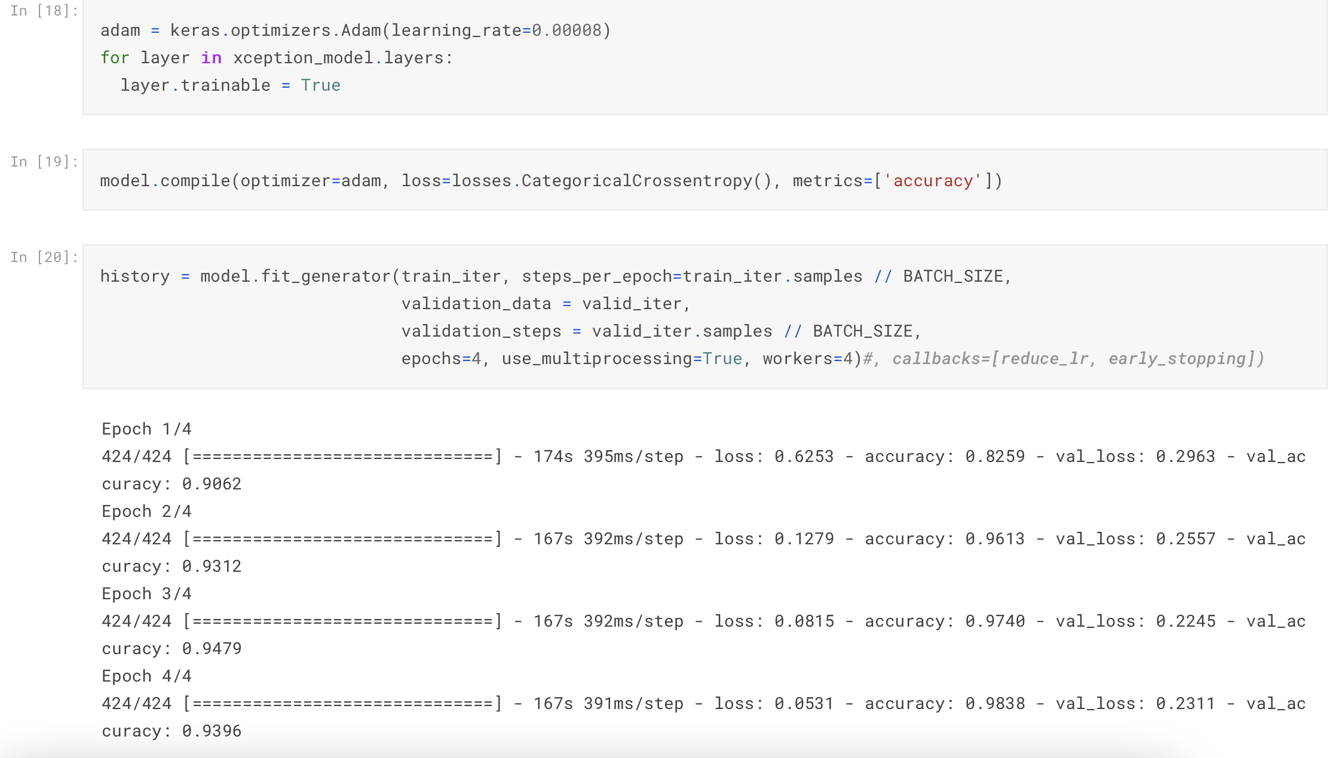
Executing the base model

Slide 32
How transfer learning helped
Xception model parameters
 | Base Model | After Freezing
Total params | 21,411,724 | 21,411,724
Trainable params | 21,357,196 | 550,244
Non-trainable params | 54,528 | 20,861,480

Slide 33
Models and Comparison
Trainable Parameters
550,244 | 157,028 | 550,244 | 353,636

Slide 34
References
https://keras.io/
https://www.kaggle.com/datasets/gpiosenka/sports-classification
https://analyticsindiamag.com/a-comparison-of-4-popular-transfer-learning-models/
https://analyticsindiamag.com/a-comparison-of-4-popular-transfer-learning-models/
https://www.geeksforgeeks.org/vgg-16-cnn-model/
https://iq.opengenus.org/resnet50-architecture/
https://www.youtube.com/watch?v=_2EHcpg52uU
https://github.como/ariamostajeran/Transfer-learning-presentation

Slide 35
؟
؟
؟
؟
؟

Slide 36
Thank you for your attention
ariamostajeran99@gmail.com zasalarian2000@gmail.com pa.mehrbod@gmail.com kiankr79@gmail.com

